Slide 1
MediaWiki Stakeholders' Group
Your wiki, our passion
Notes:
The payoff/tagline is an example

Slide 2
Our Mission
The MediaWiki Stakeholders' Group (MWStake) is a MediaWiki user group of:
MediaWiki developers
system administrators
users
consultants
hosting providers
We cooperate towards our mission in order to improve the software and advocate the needs of MediaWiki users outside the Wikimedia Foundation (WMF), its projects and the traditional Wikimedia movement.
Thus to ensure MediaWiki becomes and stays the best fit open source wiki for knowledge sharing and documentation.

Slide 3
Ecosystem and Structure
MediaWiki Stakeholders' Group is a recognized Wikimedia Foundation (WMF) affiliation. The WMF was established as a nonprofit
in 2003 to give Wikipedia ‘the largest source of human knowledge ever created’ a permanent home. Some Wikipedia numbers (2018):
Wikipedia remains the only top 10 website that's a non-profit
Wikipedia surpassed 50 million articles
Volunteers added 2.5 million new articles
250,000+ volunteers contributed to Wikipedia each month
We maintain Wikipedia with 350+ non-profit staff worldwide
People visited Wikipedia 15 billion times each month
AI bots scanned Wikipedia edits 86 million times per month to catch and correct vandalism
The MediaWiki Stakeholders’ Group Corporation was founded in 2019 to complement WMF. MWStake's current members are high profile members of the MediaWiki community. Many Members use or maintain MediaWiki in a professional environment, in corporations, highly visible sites or as advisors.
Notes:
https://wikimediafoundation.org/about/2018-annual-report/

Slide 4
Activities
Since 2014, MWStake has been caring about the needs of MediaWiki maintainers. We raise the flag in:
MediaWiki events
Semantic MediaWiki Conferences
Enterprise MediaWiki Conferences
Hackathons
Developer Summits
Discussions
Develop
Fix bugs
Work on documentation
Standardize functionality
Exchange experience
Create a network

Slide 5
Relevancy
MediaWiki is widely used. Here’s some statistics and numbers. We co-power: [#] wikis [#] MediaWiki users
[#] MediaWiki community members [#] pages
[#] articles [#] pages
Notes:
The statistics/numbers have to be added. Additional statistics/numbers are welcome

Slide 6
Workboard Topics
We validate and focus on the topics the MediaWiki Community and its Members put on the technical agenda:
Installation (Meza, Composer RfC)
Integration (LDAP)
Use cases (Fantastic MediaWikis Track)
Networking (EMWCon)
Member projects
Your project

Slide 7
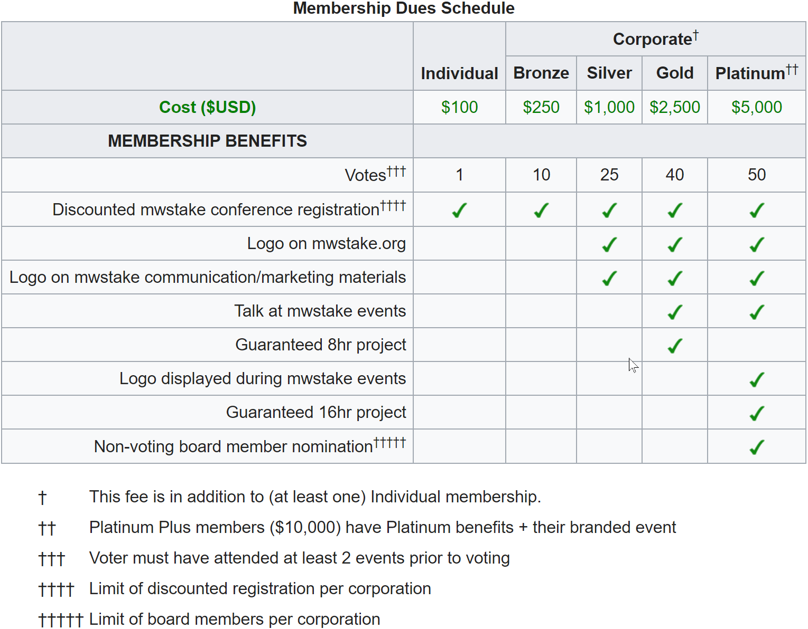
Membership
Becoming a Member, stakeholders contribute resources and money specifically to the development of MediaWiki.
Members can influence the features of MediaWiki with their resources.
Members enable MWStake to reach their Mission and Goals.
Notes:
The Schedule image should be re-uploaded. I made a change in the Schedule

